Slide 1
The impact of change on the workforce and how education providers prepare for the Future of Work November 7, 2019 World Standards Week Washington, DC Building an effective workforce for the future ANSI/Workcred
Jeff Strohl
js787@georgetown.edu

Slide 2
The Future of Work (FOW)

Slide 3
When was the last time you saw an occupation pop in or out of existence?

Slide 4
We act as though there has never been a future of work while in fact, I argue, our education and training system has co-evolved with this reality.

Slide 5
Change happens within occupations much more than between.
We need to conceptualize occupations as buckets of tasks and activities to build strategies to deal with FOW.
We have occupationally based estimates of risk to automation as high as 48%, while moving to a view of task portfolio this estimate drops to 8%.

Slide 6
The question about the future of work that raises concern is whether the speed of change at the task level is faster than education and training programs can react. At this point OJT has to kick in.
Standardization and bite sized offerings(e.g. Certifications) can offer a balance of quality and responsiveness to align at the margins
We must be wary of over-vocationalization though; too much specific education holds an economy back from the Productions Possibilities Frontier by hindering technological absorption.

Slide 7
America needs crisis in education (or do we?)

Slide 9
Thinking about the future of work

Slide 10
Lets think about the future of work via a series of questions
What characteristics of education and training systems define how they react to the future of work?
What is it about the quickening pace of change that can cause the existing model to break down?
Do fixed costs lock us into a rate of change(ROC) that is manageable thereby reducing the ROC to a technological leapfrogging problem that happens on a cyclical basis?

Slide 11
One key characteristic of the relationship between education and work is time.
A functional education system must bridge this time gap

Slide 12
The time gap can be bridged in a number of ways:
Collaboration with employers to define emerging tasks, skills, competencies, etc.
Employment projections defining growing and declining occupations informs enrollment investments but leaves curriculum development divorced from the workplace. We need employer participation to build good feedback.
Balancing general and specific education.

Slide 13
Education Work
Time distance
Curriculum reaction Demand signal
Feedback cycle

Slide 14
When the time distance between work and education becomes compressed curriculum response to labor market signals can slow.
The system has always had this problem and it has traditionally been remedied by employer provided training, OJT, or efforts like apprenticeship that bring the workplace and classroom closer together.

Slide 15
So do we need to worry?
We see evidence that the system has been undergoing structural changes that by themselves collapse the time distance.
In 1993, as identified by Erica Groshen et al, the US employment model began moving to a fire model from a layoff model (aka: jobless recovery).
The movement away from layoff began the movement towards spot market for skills (hire in boom/fire in bust) which raised the ante on qualifying skills.

Slide 16
The movement towards increased demand for qualifying skills naturally pushes the need for specific training onto the education system and the potential employee.
Change in task/skill needs –especially those that are ‘bite sized’ has increased demand for certificates and more importantly certifications (we think – no good baseline).

Slide 17
I will argue that the large demand for certifications (30% hold active certification) in the labor market reflects evolution of our education and training system to a one that can more rapidly adjust to skill/task transformation.

Slide 18
The Balance of General and Specific Education becomes more important in an environment demanding quick responsiveness

Slide 19
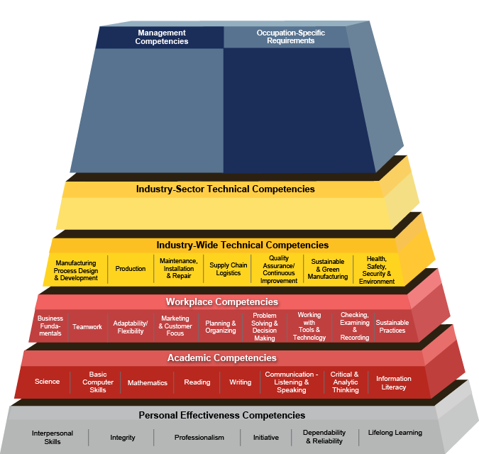

Slide 20
Thinking back to time distance between education and labor market preparation.
Employers are demanding work readiness at day of hire but the strength of the US system is in provision of a balance of general and specific education.
The competency model framework appeals to me because its logic parallels the concept of time distance.
General education provides the foundation while specific education is most effective closer to the labor market.

Slide 21
The stackable certificates model is also a good way to think about improving how education and training systems can evolve to better react to market changes.
If I am correct that change is at the task level, and we think about the first layers of the stack of education being general, and thus having less time-decay, then system reactiveness is enhanced by modifying the most specific –and most recent layer – sort of the icing on a cake.
I like to think about this in terms of general education teaching algorithmic thinking and the specific teaching C++ vs Ruby on Rails.

Slide 22
The final question: Will change speed up so much that standardization/quality control is out the window?
I personally doubt this. I believe that fixed costs associated with technological and physical infrastructure lock any given company into a set of processes that can, at least, be captured by certifications standards if not standard PSE.

Slide 23
Questions?
js787@Georgetown.edu

